Slide 1

PVE Continental Challenge in Sitting Volleyball
Prospectus

Slide 2
Overview
Organised every year
  Schedule is negotiable and relies on interest
Open for National teams from PVE member nations
Maximum 12 slots for men teams
  “short-form” is possible, as for Sub-Zonal events
NB. While a full competition format is preferred, bids using the Sub-Zonal format will be considered.

Slide 3
Who are potential Local Organisers (LOC)
Any LOC must be a member or supported by the National Paralympic Committee in WPV member countries in PVE zone
LOC may be:
  National Paralympic Committee
  National Sport Federation
  Regional Sport federation
  Sport club
  Any local or national government body
  Any other organisation accepted by PVE

Slide 4
Index
Finance
Fees
Local Organising committee
Venue facilities
Training facilities
Accommodation
Meals
Transport
Ceremonies
Meetings
Teams and officials
How to make a bid

Slide 5
Finance
PVE is responsible for all travel costs for international officers
Participating teams are responsible for all international travel costs for their own team.
LOC is responsible for all local travel costs, all technical equipment, board and lodging from the day (PVE officers two days) before the first competition day until one day after the last competition day.
The LOC’s responsibility is for all participating team members and nominated international officials.
LOC is responsible for all sport facilities

Slide 6
Fees
Fee for PVE
  Registration fee
  Referee travel fee
These fees will be invoiced by PVE
Fee for LOC
  Team participation fee
  Team member participation fee
The amount of these fees is subject to negotiation between LOC and PVE and is comparable with IPC membership fee scale
These fees will be invoiced by LOC

Slide 7
Local Organising Committee (LOC)
The local organisation must at the minimum have these area managers.
President
International
Manager
Information
Manager
Competition
Manager
NOT /
Volunteers
Manager
(Not Official
Technical
Personnel)
Transport
Manager
Venue
Manager
Food and
accommodation
Manager
Finance
and
Marketing
Manager
PVE 2014 / mcz
Notes:
7

Slide 8
Venue facilities
The venue must minimum have
  2 official match courts (one as main court)
  All necessary equipment as described in the rules
  6 dressing rooms for teams
    6 showers in each dressing room
  2 extra dressing rooms for men/women team members of other sex
  2 dressing rooms for international referees (men / women)
    One lockable locker room for each referee
  Classification / massage room
  Medical room
  Video platform for teams for video recording the games
  Public stand for 300 spectators each court (500 on the main court)
  VIP stand for 30 spectators (LOC and ECVD) on the main court
  ECVD meeting room with computer including USB port and internet connection, printer and copy machine.

Slide 9
Training facilities
The training venue must have as a minimum
  1 match court
  2 dressing rooms for teams
    6 showers in each dressing room
  2 extra dressing rooms for men/women team members of other sex
  Massage room

Slide 10
Accommodation
LOC must prepare accommodation for team members in two or three bed rooms
LOC must prepare accommodation for international referees in single bed rooms
LOC must prepare accommodation for PVE officers in single bed rooms
LOC must offer accommodation for international guests at their own cost.

Slide 11
Meals
LOC must prepare 3 meals every day
  Breakfast must start at the latest 3 hours before the first match every day
  Lunch must be possible to start at least three hours before the teams’ next match
  Dinner must be possible to start one hour after the end of the last match
There must be alternatives for ethnic requirement
  All food must be labelled for ethnic requirement
One of the meals must be hot meal (dinner)

Slide 12
Transport
LOC must prepare transport
  On arrival and departure from / to the nearest international port of entry and to the Championship city.
    The distance should not be more than 3 hours by bus in rush hour traffic.
  During the Championship, every half hour between the Championship venue, training venue and accommodation.
    The distance should not be more then ½ hour one way by bus in rush hour traffic.
    The transportation must start 1 ½ hour before the first match each day.
      The first arrival in the main venue every day must be 1 hour before the start of the first match.
    The transportation from the venue must end at the earliest ¾ hour after the end of the last match if the teams require it.

Slide 13
Ceremonies
LOC must prepare
  Opening ceremony with
    Presentation of the teams
    Cultural program
  International playing protocol for each match
  Closing ceremony with distribution of awards to all participating teams and to team members of the 3 first places.
  Farewell party on the last evening

Slide 14
Meetings
LOC must prepare meeting rooms for
  Technical meeting for 60 persons
  Referee meetings for 25 persons
  PVE board meetings for 10 persons
Minimum equipment in the meetings:
  Microphones/speakers
  Computer
  Electronic projector

Slide 15
Teams and officials
Each team is allowed to enter the Championship with 17 team members
  12 men teams x 17 members = 204
    From past experience the average number of team members is 12
There will be up to 8 PVE officers
There will be one referee per participating team
  12 referees for men teams
Total number of teams and officials is maximum 216
    From past experience the numbers do not usually reach the maximum

Slide 16
How to make a bid
First send a letter / E-mail to PVE that you are considering making a bid for the Championship
  At this stage it is important for LOC to appoint the LOC International Manager able to communicate by E-mail in English language.
After contact with PVE you will be asked to
  Fill-in the BID book
  Describe your organisation
  Present a preliminary budget
  Make a presentation of the venue and accommodation
After acceptance of your bid LOC and PVE will sign a contract describing the duties of PVE and LOC.

Slide 17
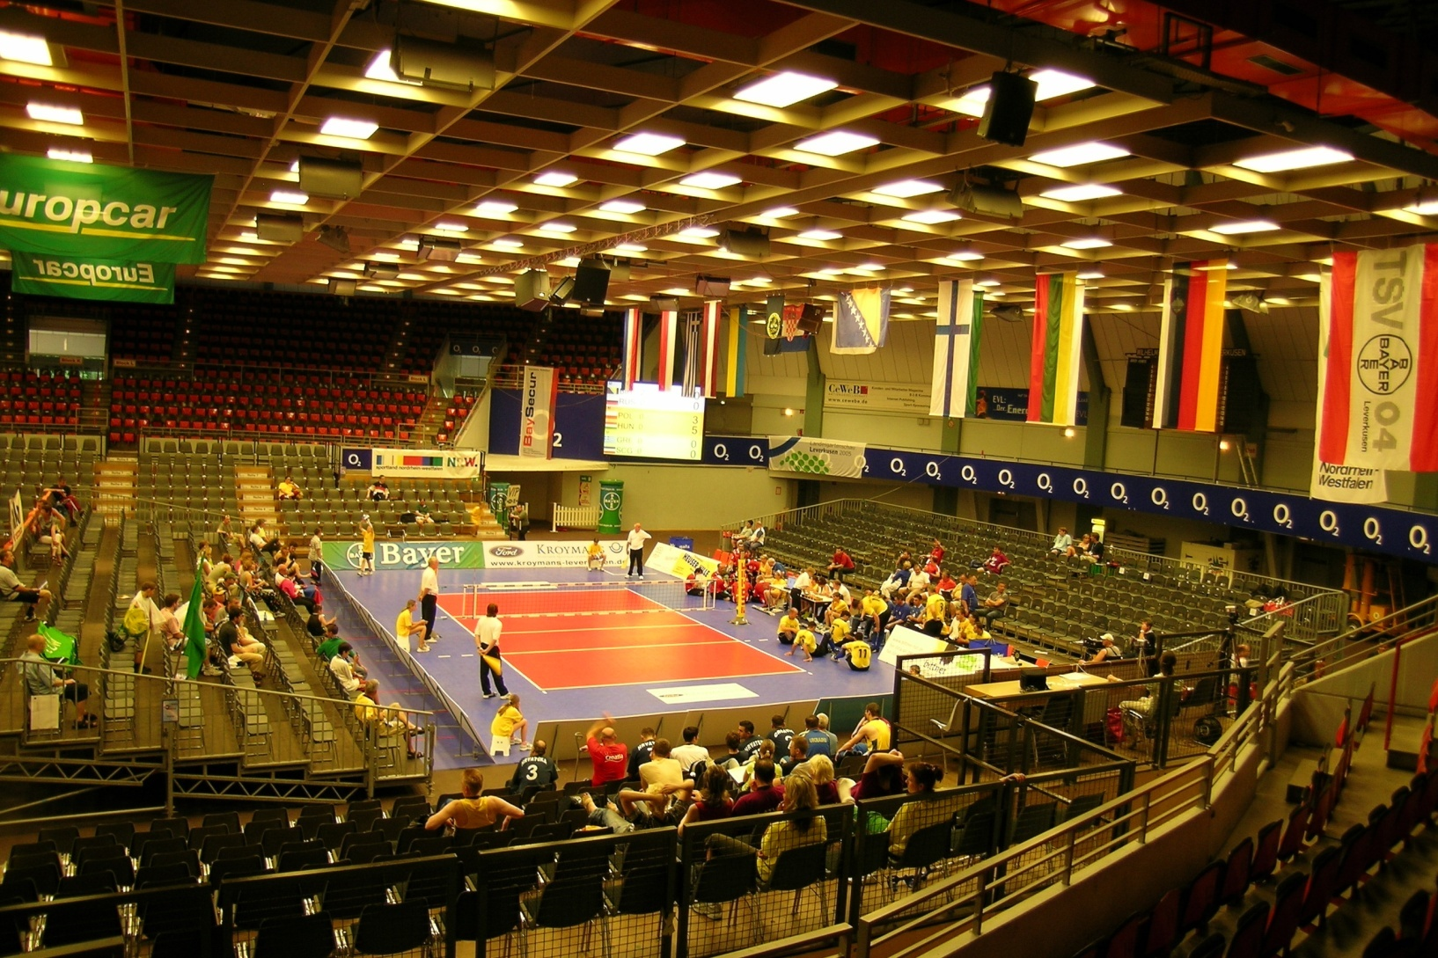
Are you the next LOC ?

